Slide 1


Resume Classification Using Machine Learning
Project by:
K. Dhaneswar Reddy
Tarun Sai Krishna Murthy
K.Sankrith
Prasanna Sanjay Patil
Parth Patel Hiteshbhai
Supreet Amrad
Vikas K N

Slide 2

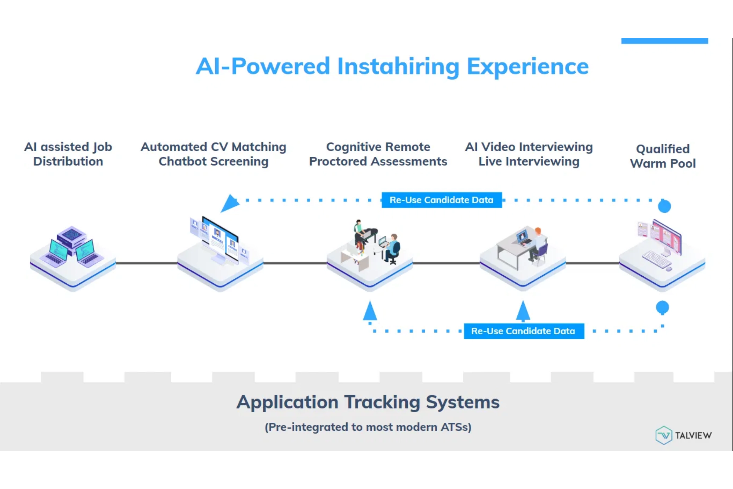



Introduction
Manual resume screening is
time-consuming
and inefficient
Need for
automation
in recruitment
processes
Solution:
Machine Learning based resume
classification

Slide 3
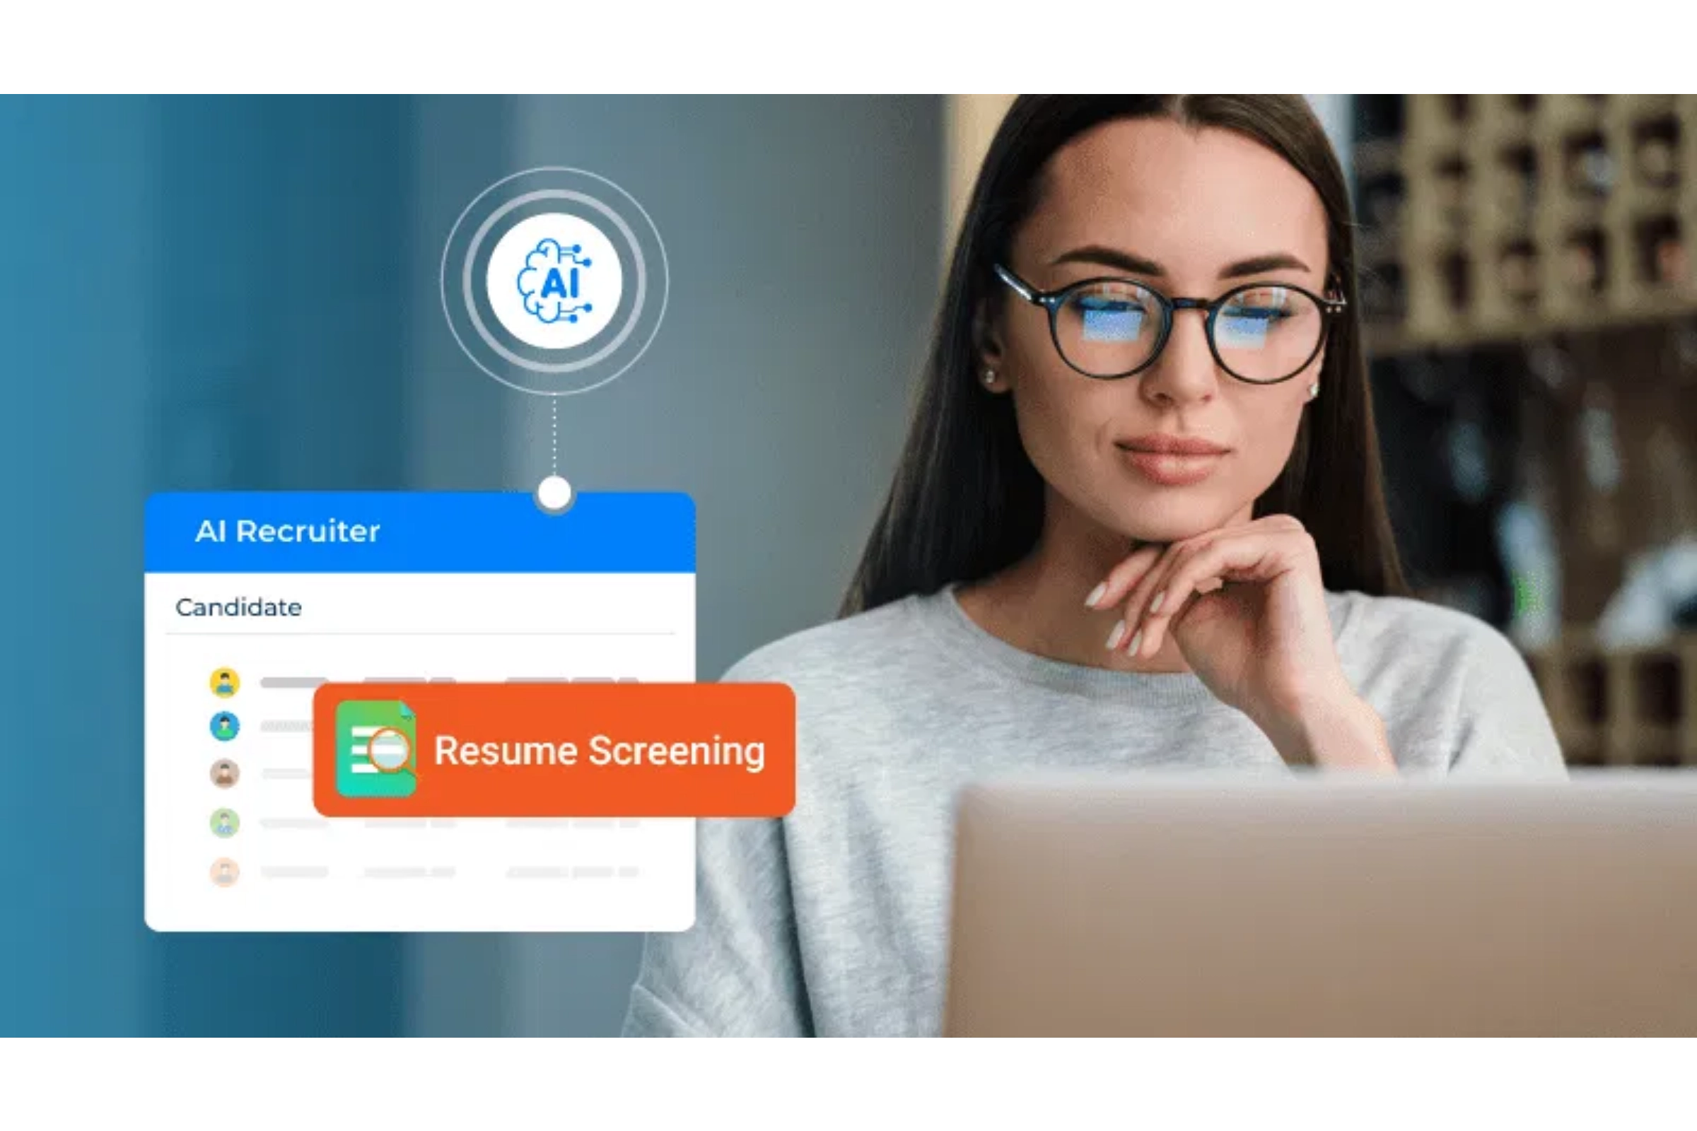




Project Objectives
Automate resume categorization
Extract text from resumes (PDF/DOCX)
Build ML models for classification
Deploy as a web app for easy use

Slide 4
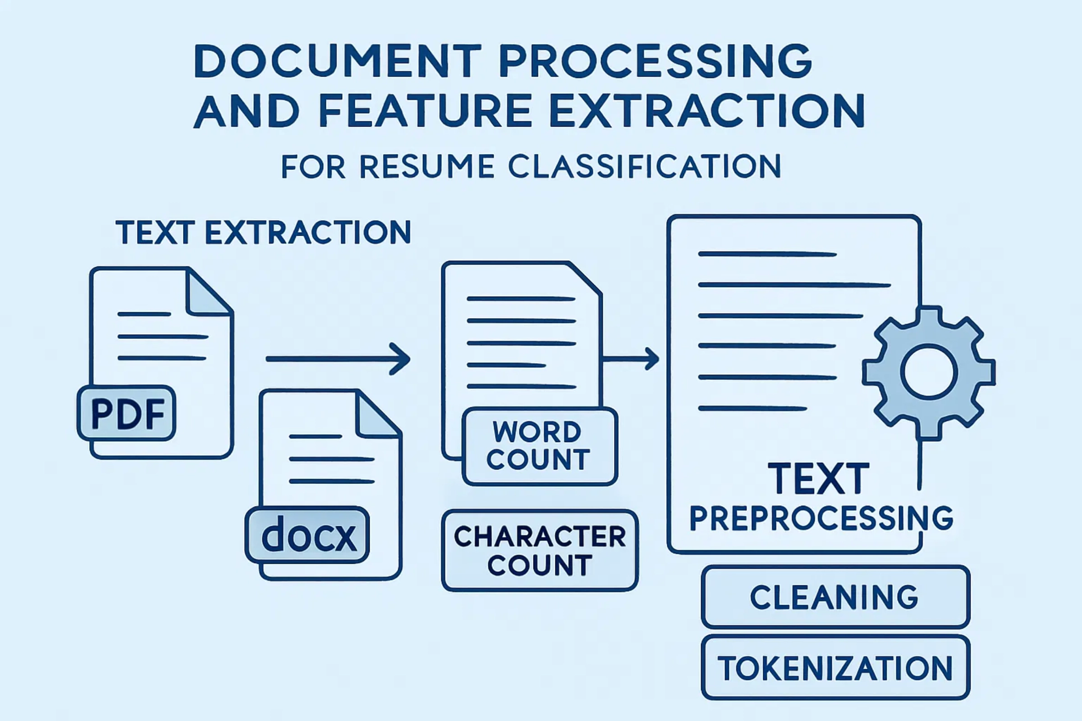



Dataset & Features
Resumes collected with
labeled categories
Features:
Text, Word Count, Character Count
Preprocessing:
Cleaning, Tokenization, TF-IDF
TF-IDF Vectorization
Converts text data into numerical features by measuring term frequency and inverse document frequency

Slide 5
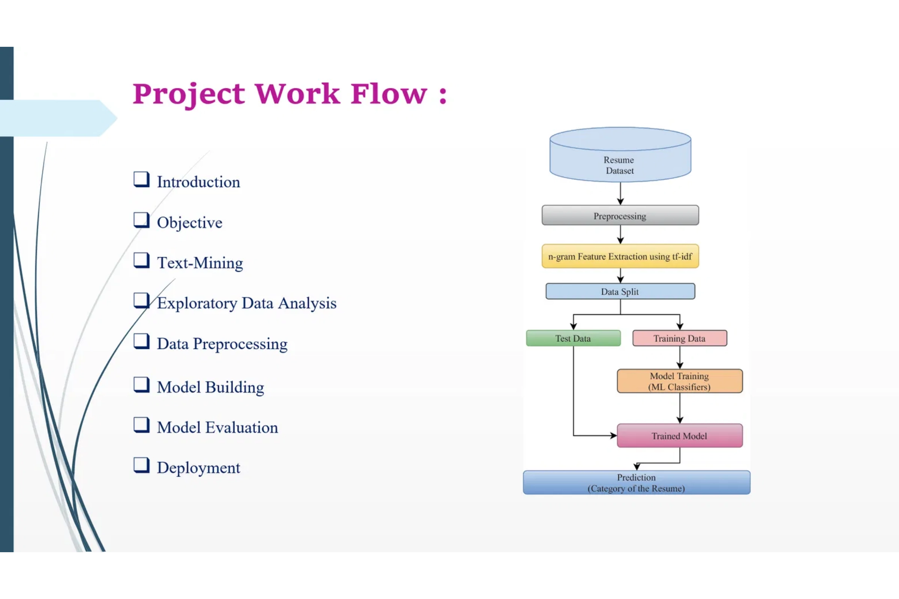
Methodology
Project Workflow:
1
Data Collection
2
Preprocessing
3
Feature Extraction (TF-IDF)
4
Model Training & Evaluation
5
Deployment with Streamlit

Slide 6

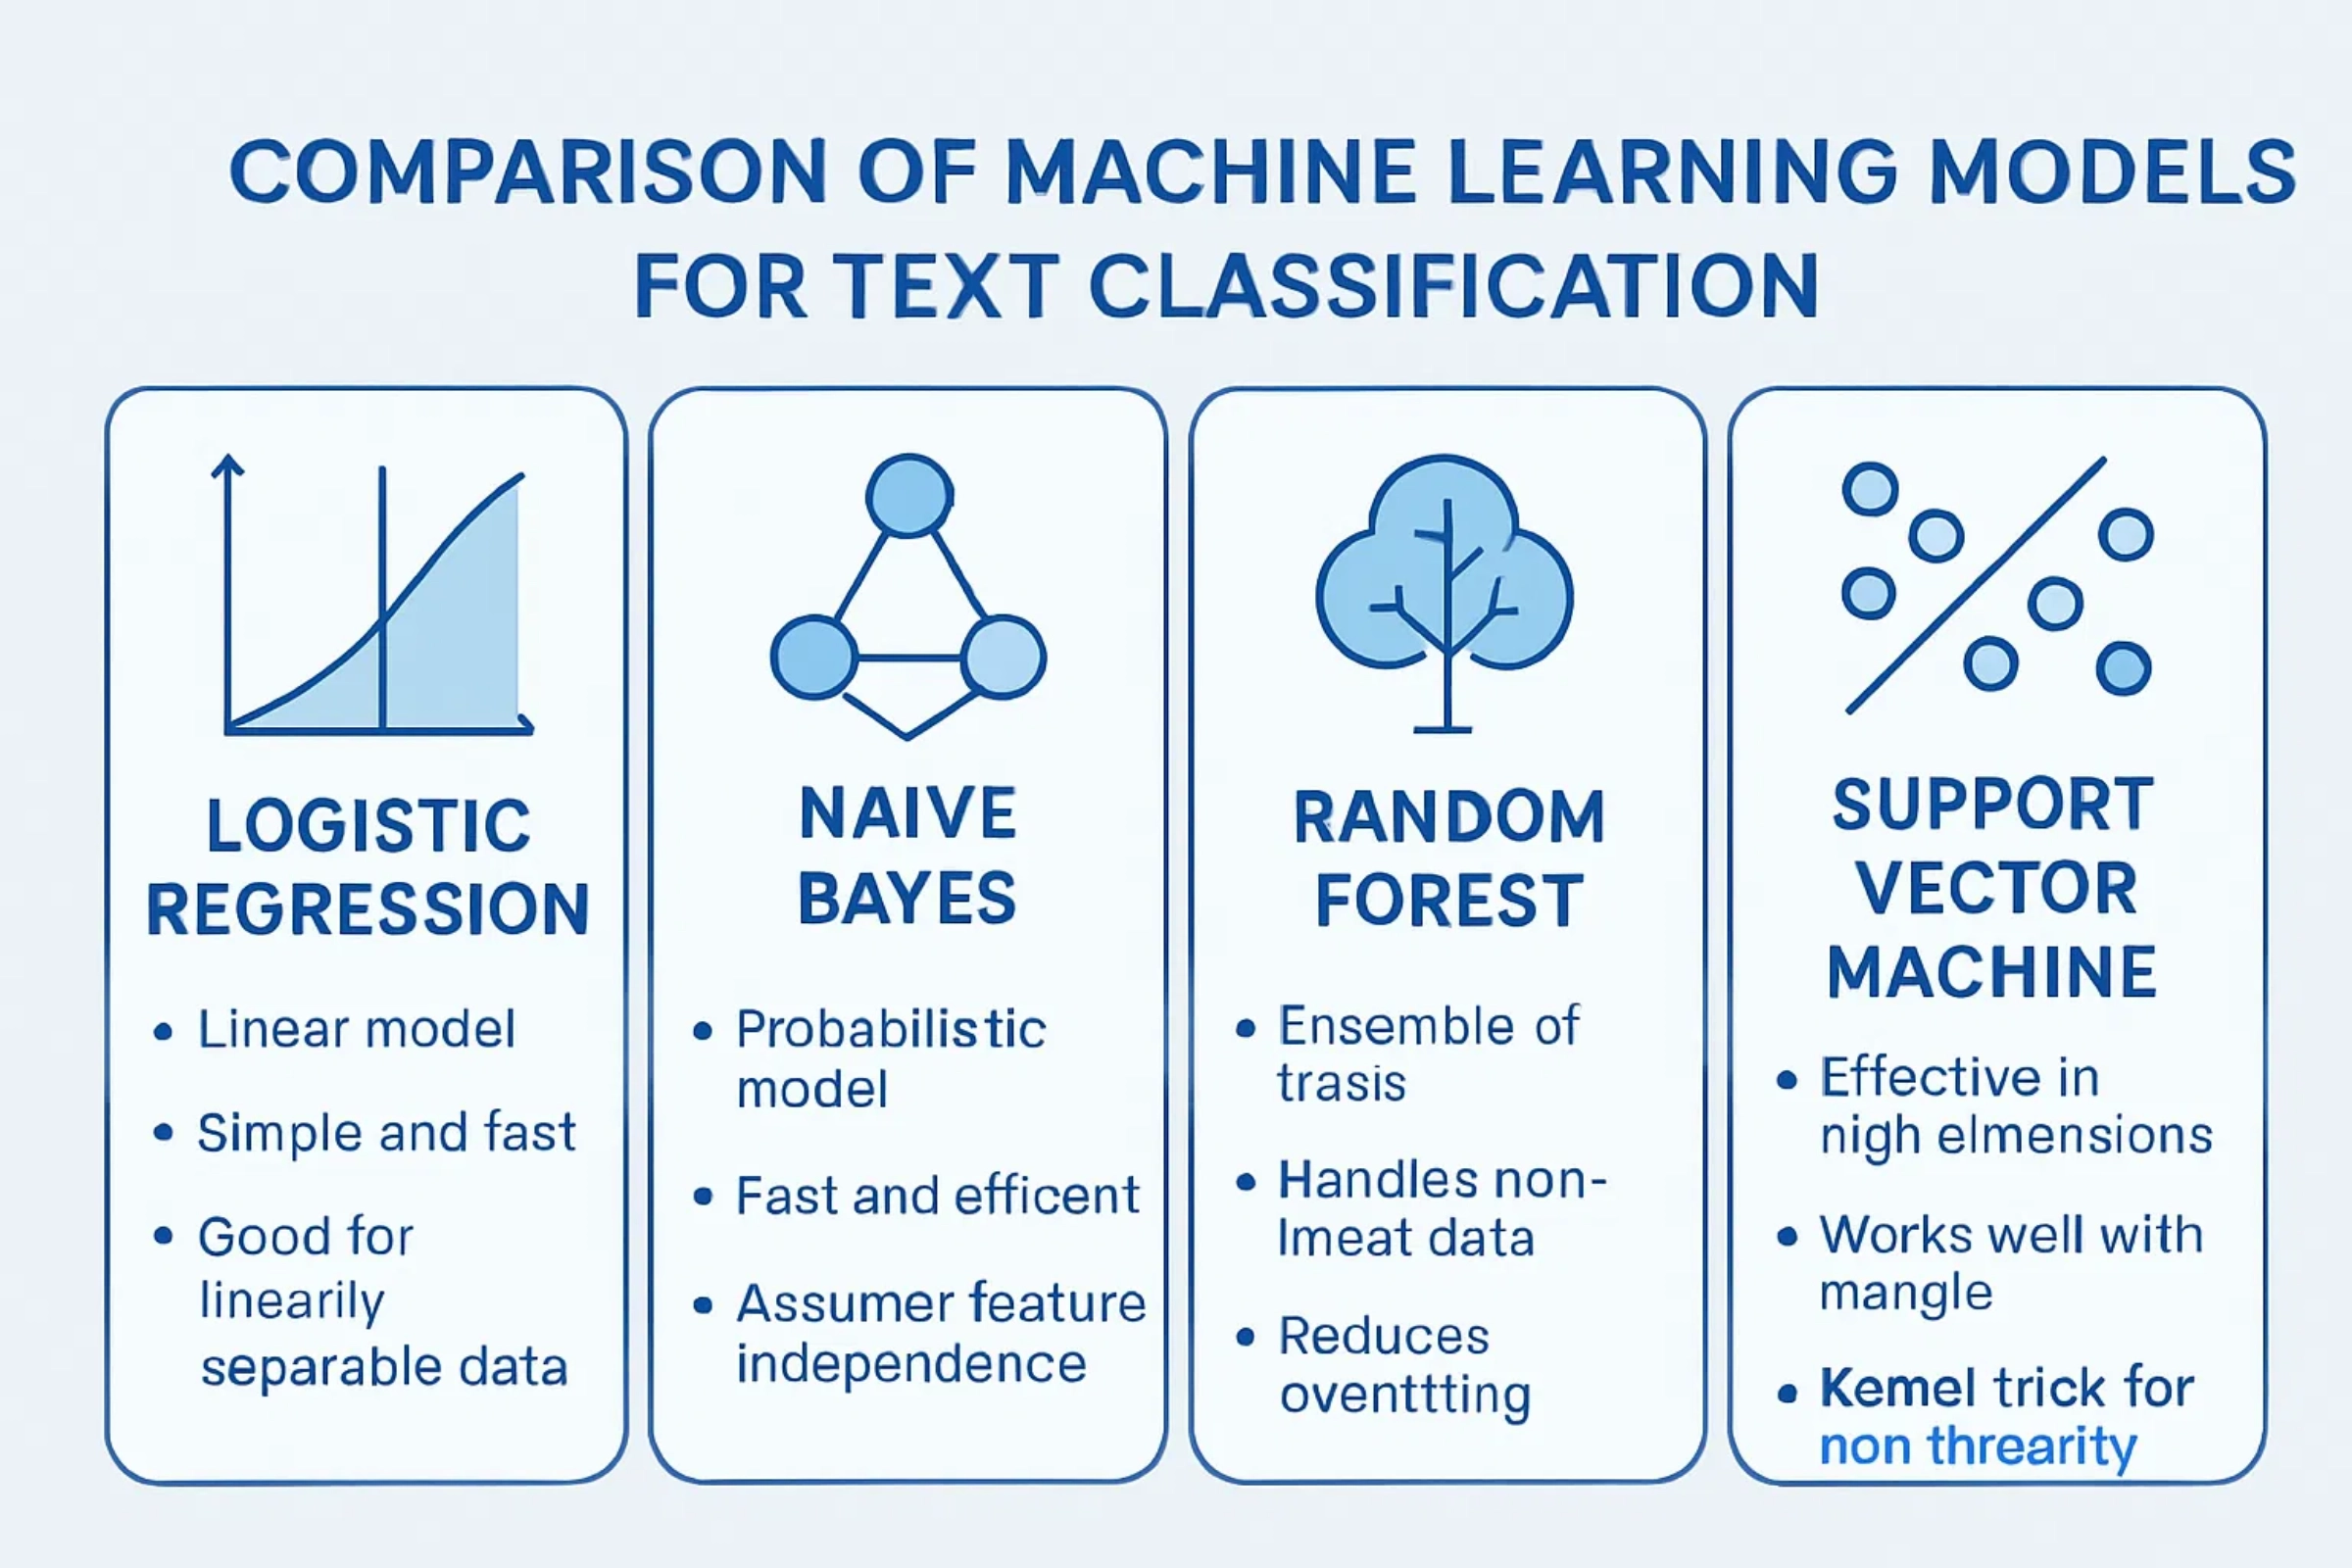
Machine Learning Models
Logistic Regression
Naive Bayes
Decision Trees
Support Vector Machine
Simple and efficient for text classification
Fast with feature independence assumption
Excellent ML model with high accuracy
Effective for high-dimensional data

Slide 7
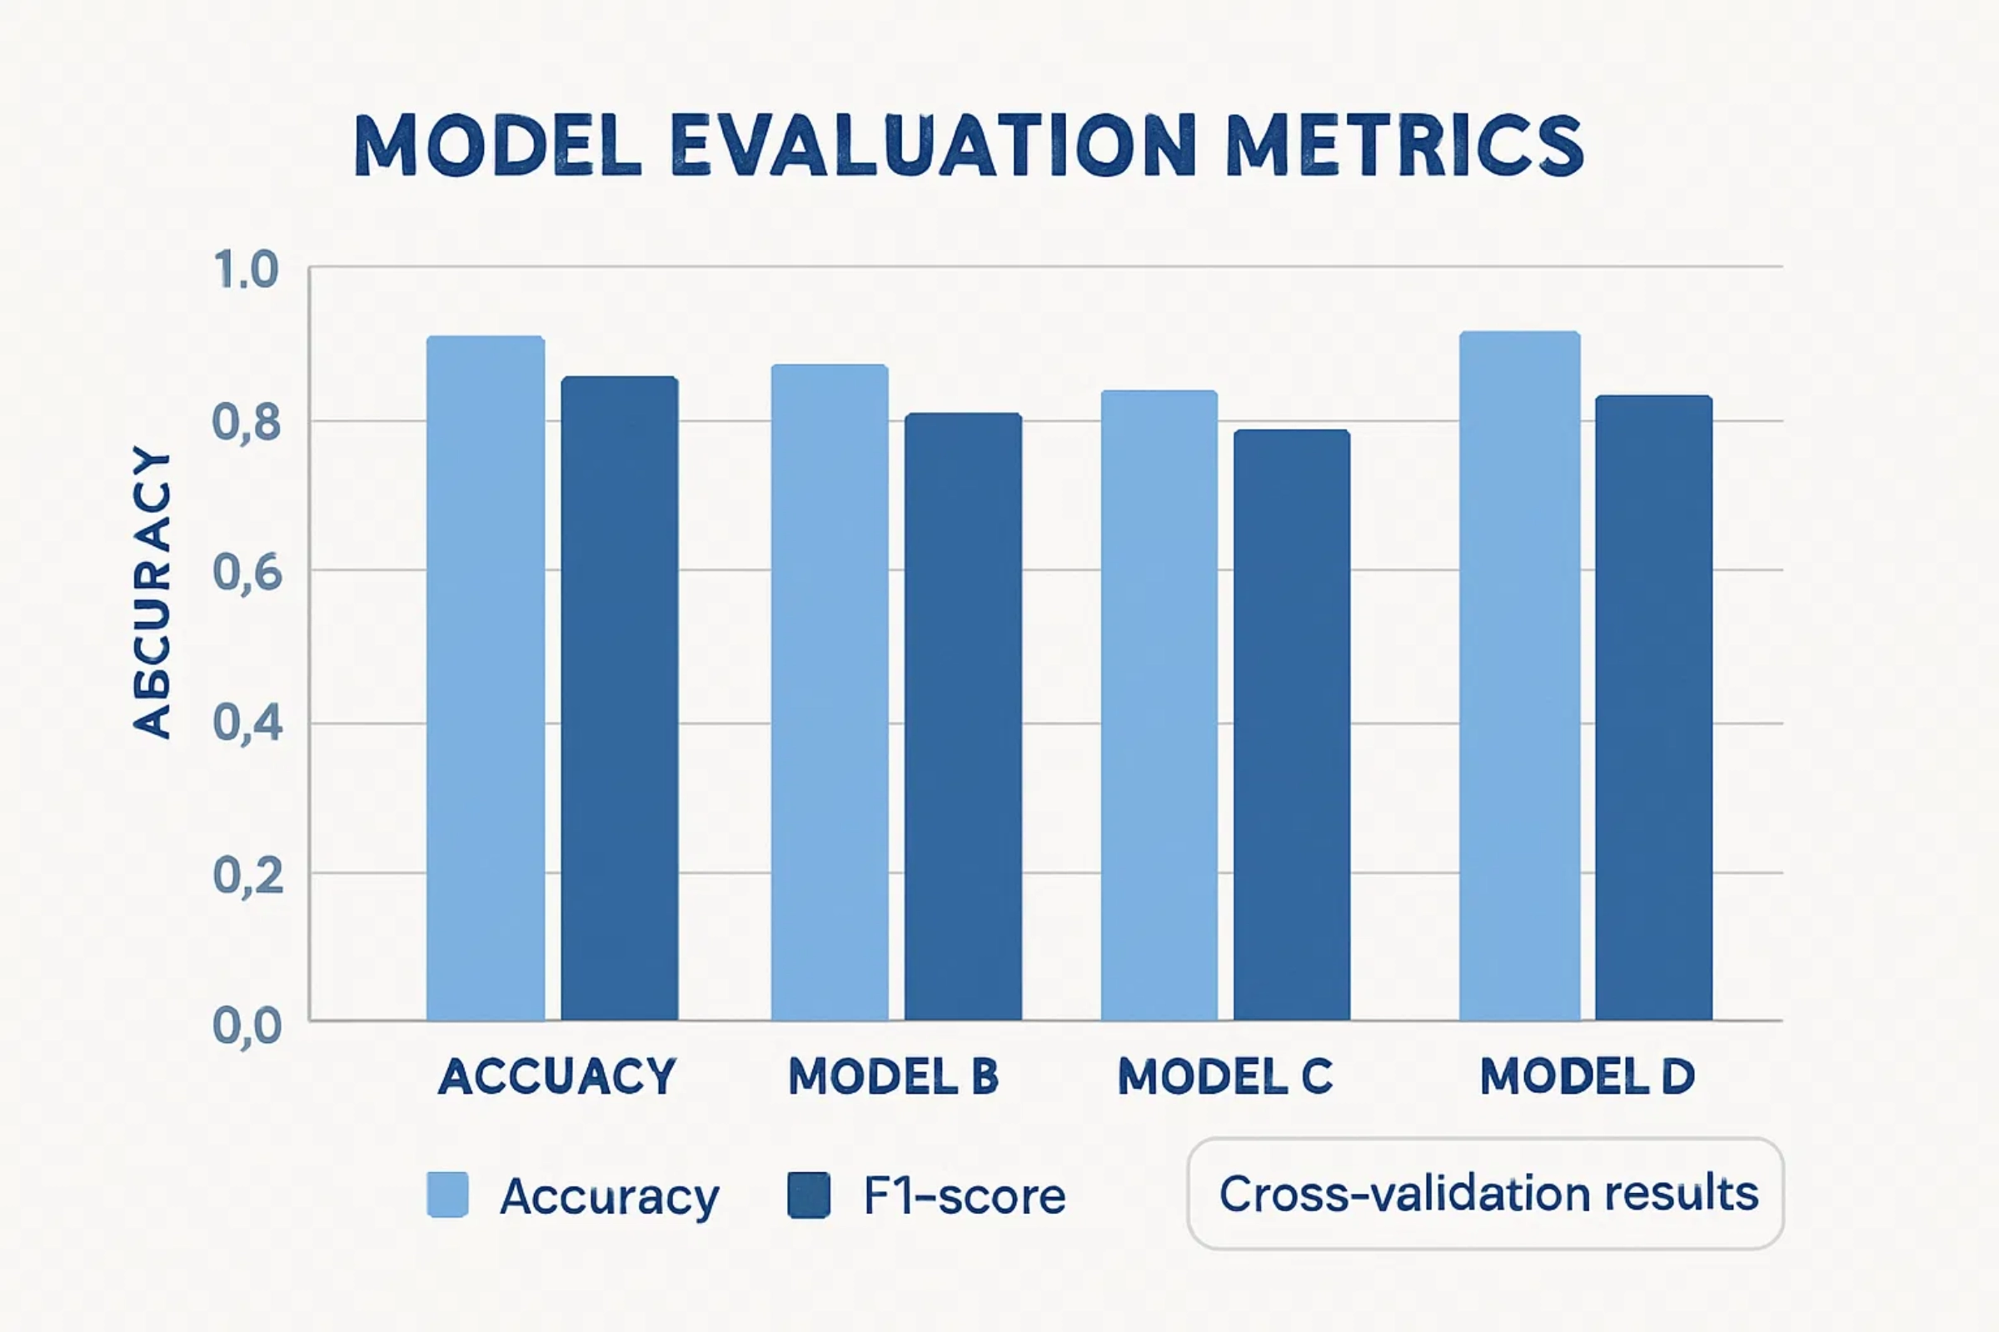




Model Evaluation
Metrics:
Accuracy
and
F1-Score
Models compared using Accuracy Score
Selected best performing model based on overall metrics
Decision Tree model achieved highest accuracy

Slide 8
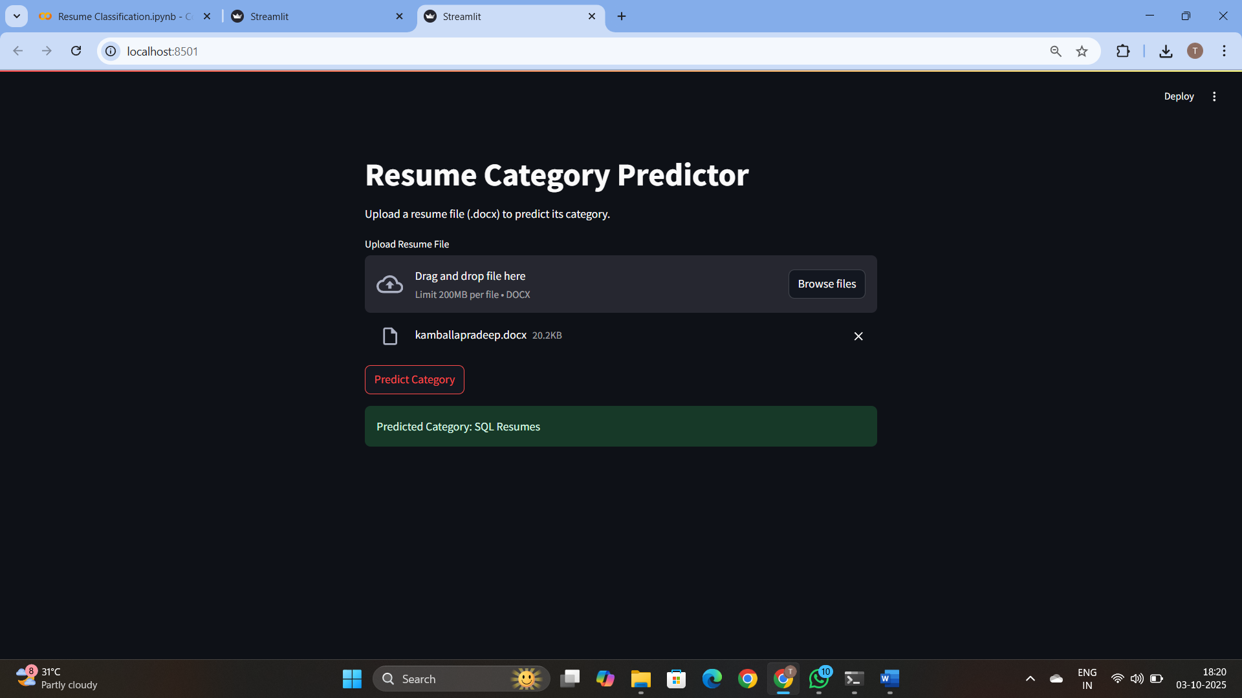



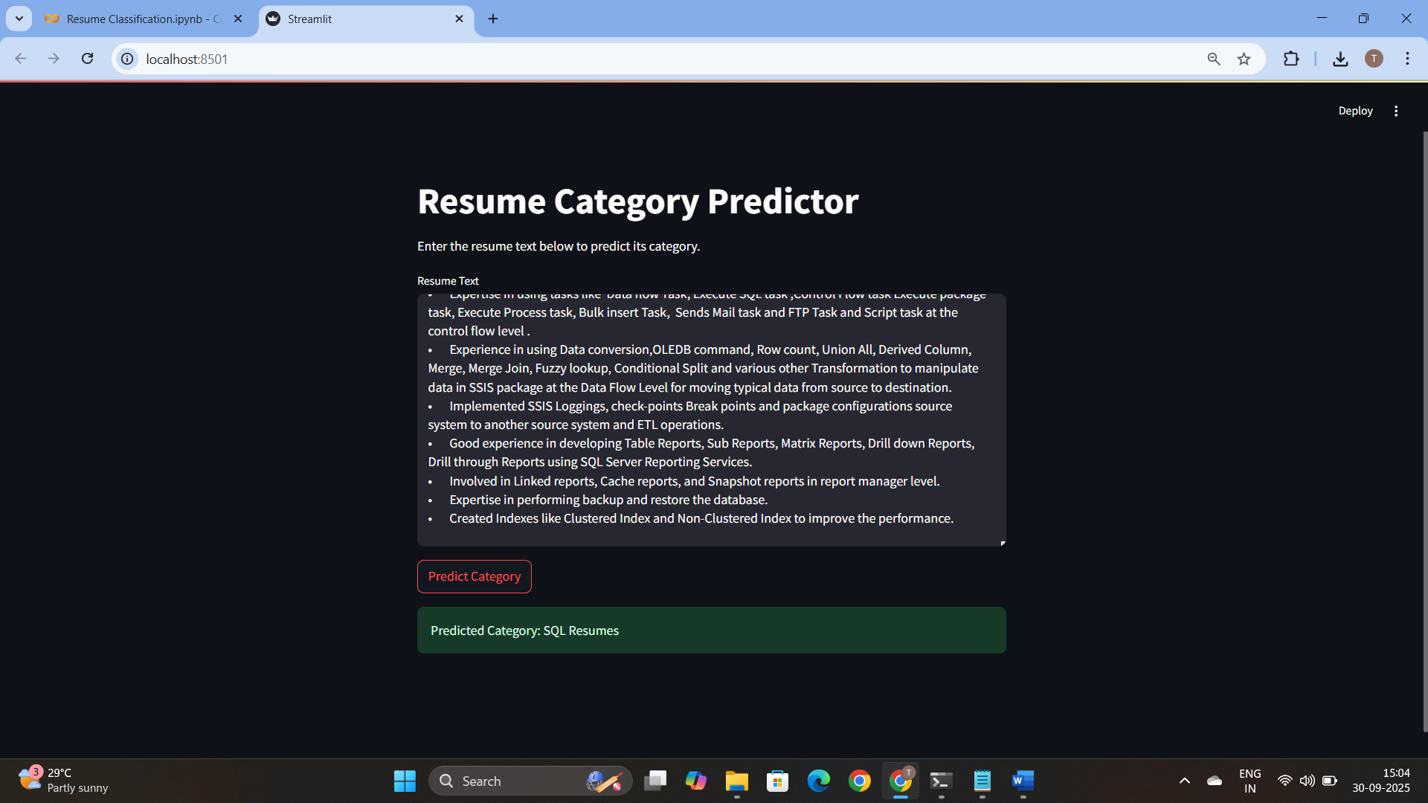

Deployment
Streamlit Web Application
Upload Resume
Extract Text
Predict Category

Slide 9
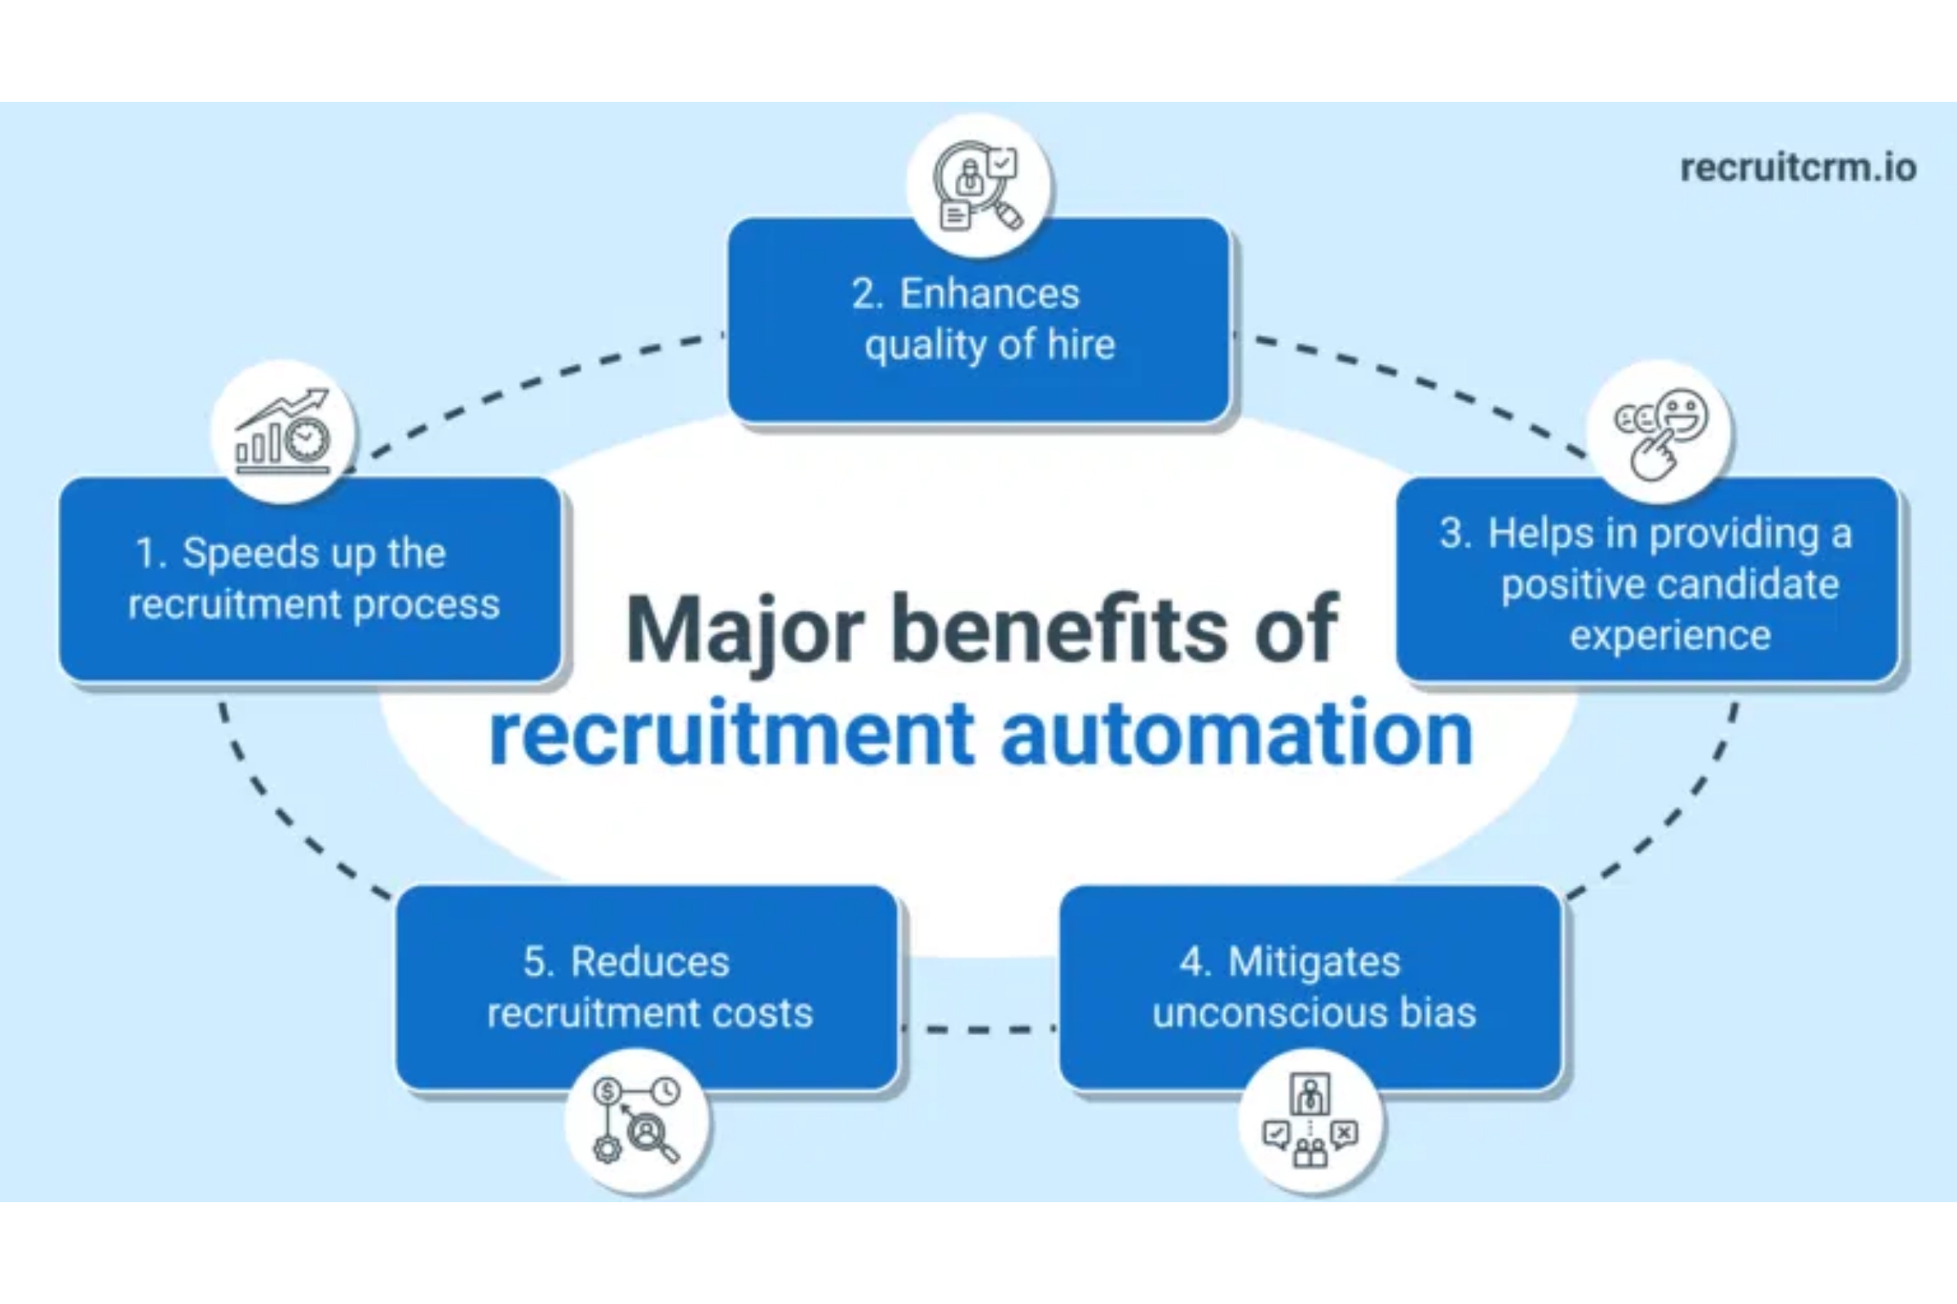




Results & Benefits
Fast and Accurate Classification
Reduces screening time from hours to seconds
Saves HR Effort
Allows HR teams to focus on high-value tasks
Scalable to Multiple Domains
Can be trained for various job categories
Real-world Applications
Practical solution for recruitment industry

Slide 10
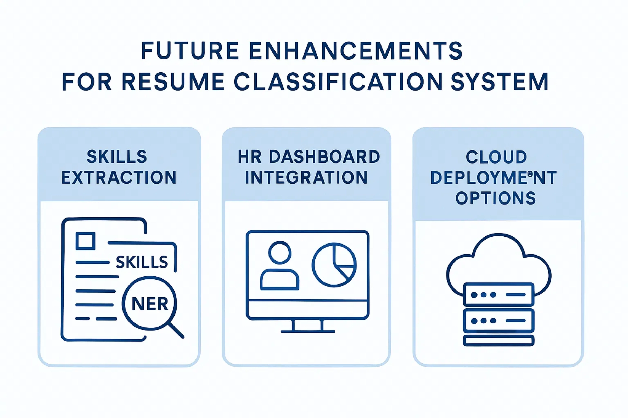

Conclusion & Future Work
Achievements
✓ Successfully implemented
resume classification
using machine learning
✓ Automated the
time-consuming
manual
screening process
✓ Deployed a
user-friendly
web application
Future Scope
Add skills extraction using Named Entity Recognition
HR dashboard integration
Cloud deployment for scalability

